Slide 1

Week 2 Raspberry Pi Pico
Fundamentals of IoT
Dr. Eoin Rogers (eoin.rogers@tudublin.ie)

Slide 2
Lesson Outline
Introducing the Pico WH (our first piece of hardware)
Basic pinout for the Pico WH
Programming the Pico WH using MicroPython

Slide 3
Raspberry Pi Pico WH
Our first piece of hardware!

Slide 4
Specs
RP2040 microcontroller (dual Cortex M0 @ 133MHz, 256KB RAM)
2MB of flash memory (disk space)
26 GPIO pins, SPI and I²C support
Software FP support(!)

Slide 5
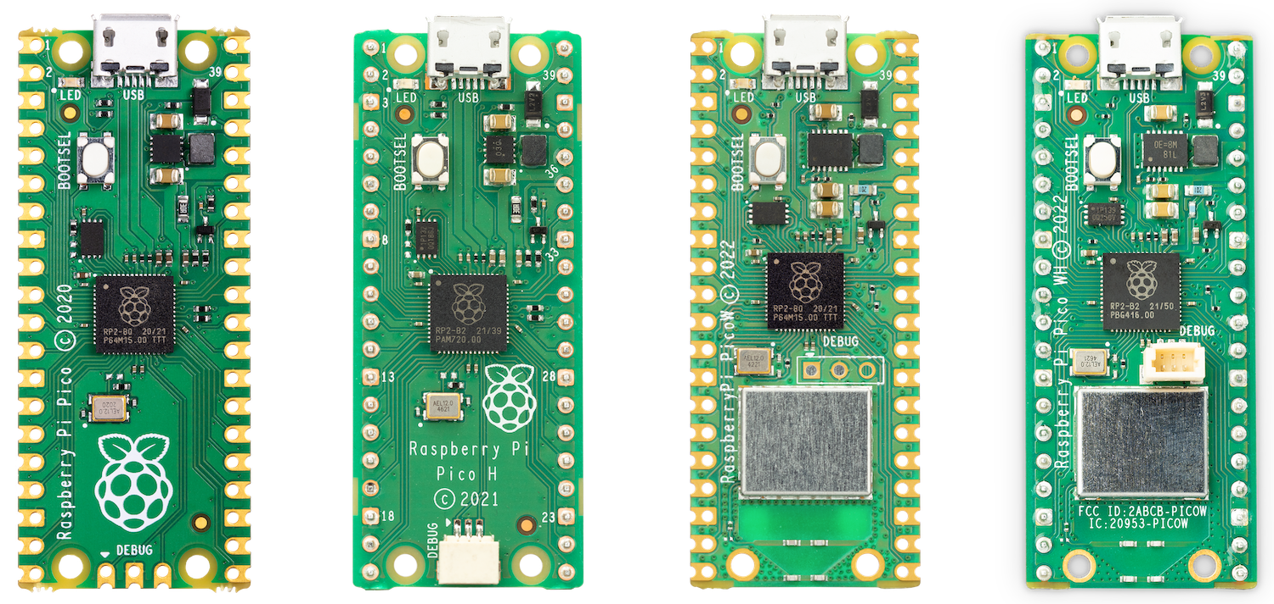
Pico 1 family

Slide 6
Pico 1 family
Raspberry Pi Pico WH

Slide 7
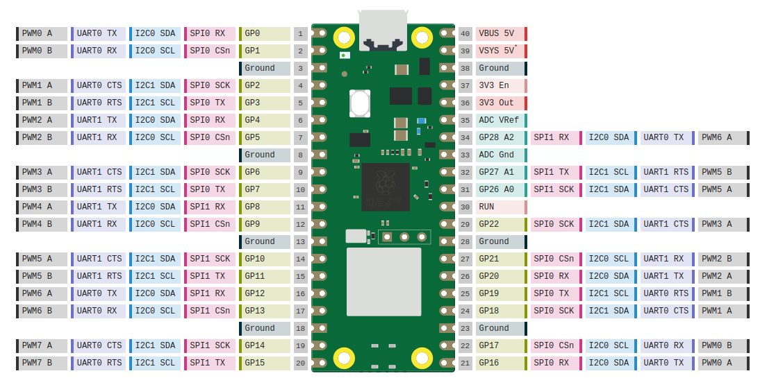
Pico W(H) pinout

Slide 8
More electronic components
Some assorted components we can connect to the Pico

Slide 9

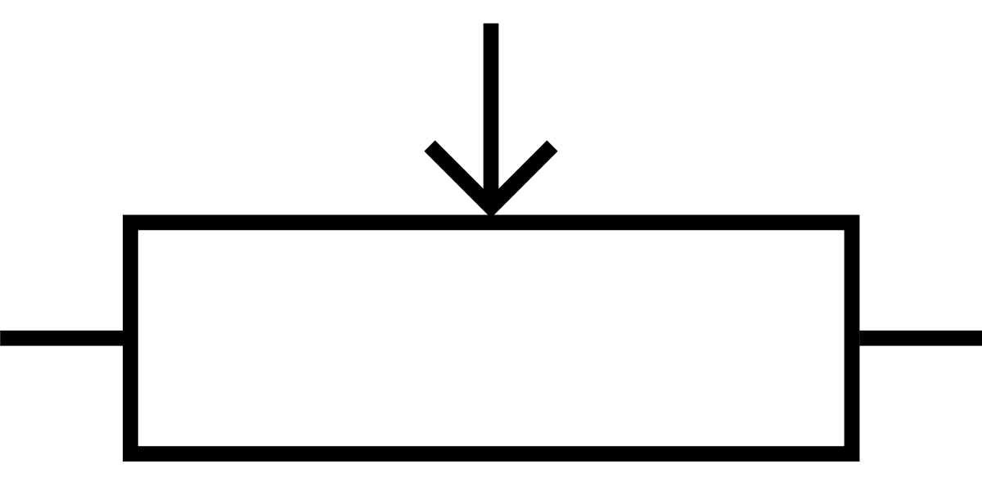
Potentiometer

Slide 10
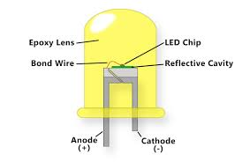

Light emitting diode (LED)

Slide 11
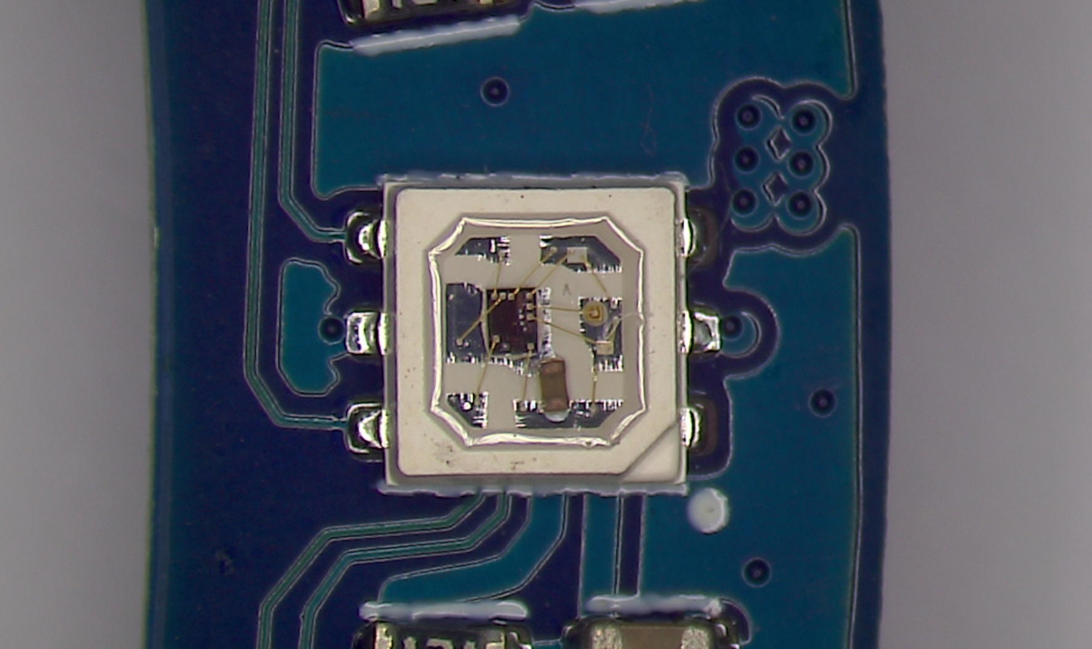
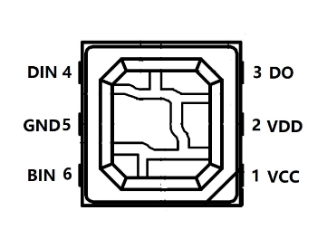
RGB LED (WS2813 mini)

Slide 12
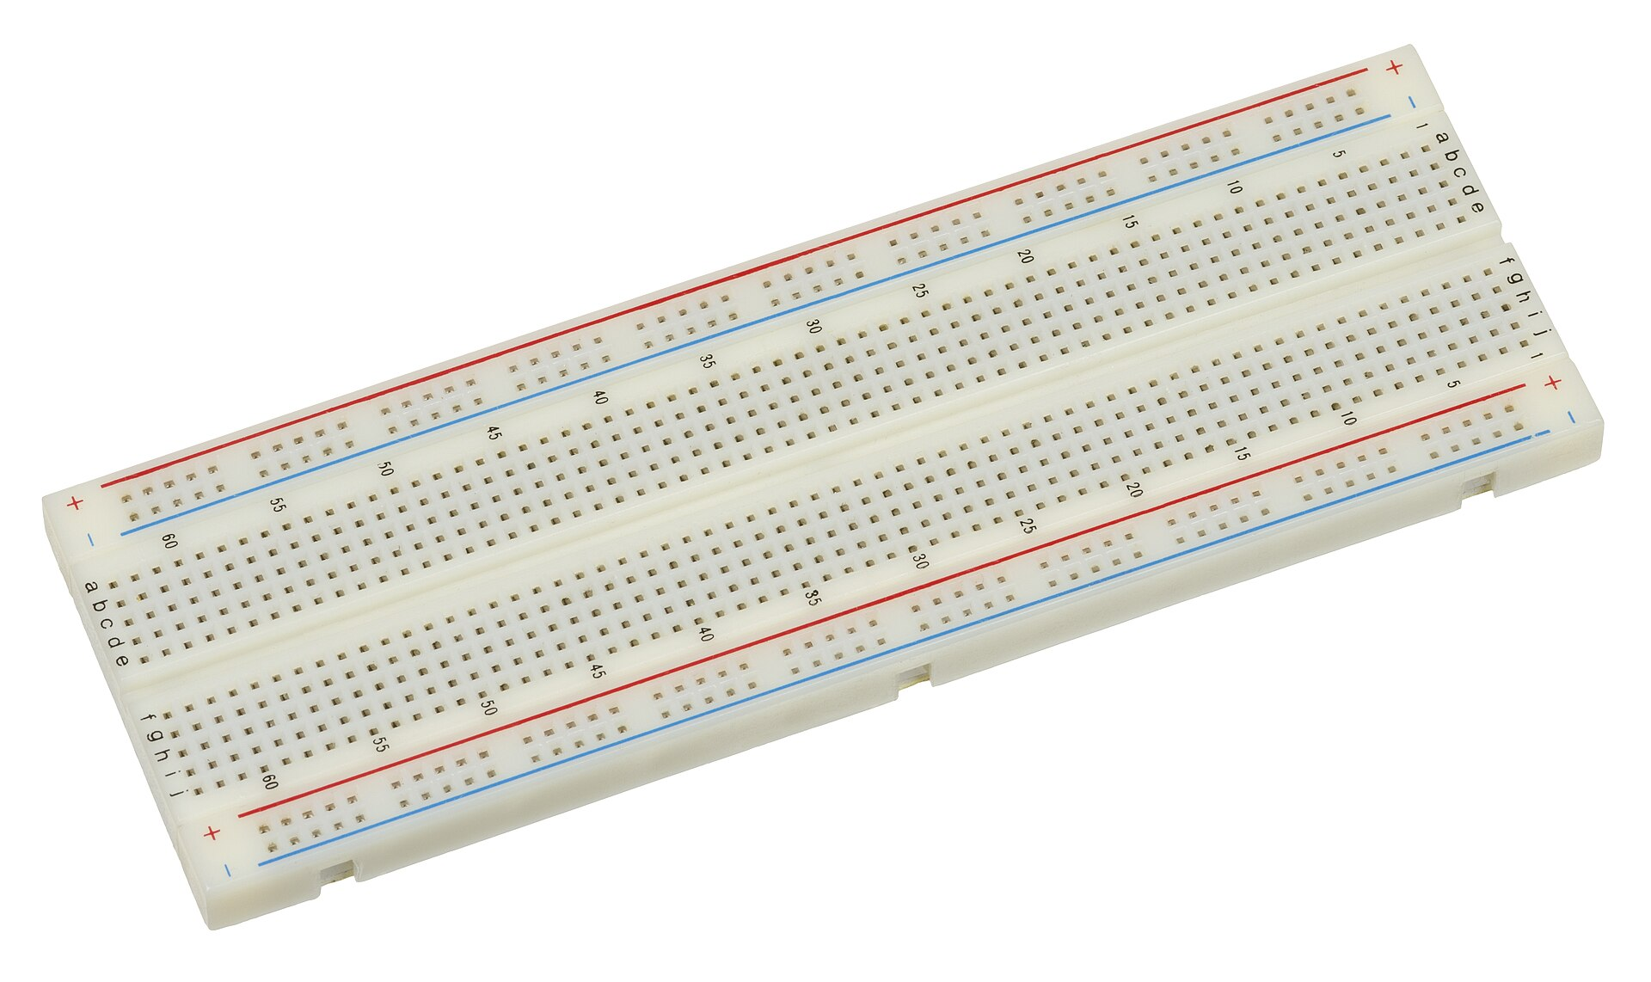
Breadboard

Slide 13
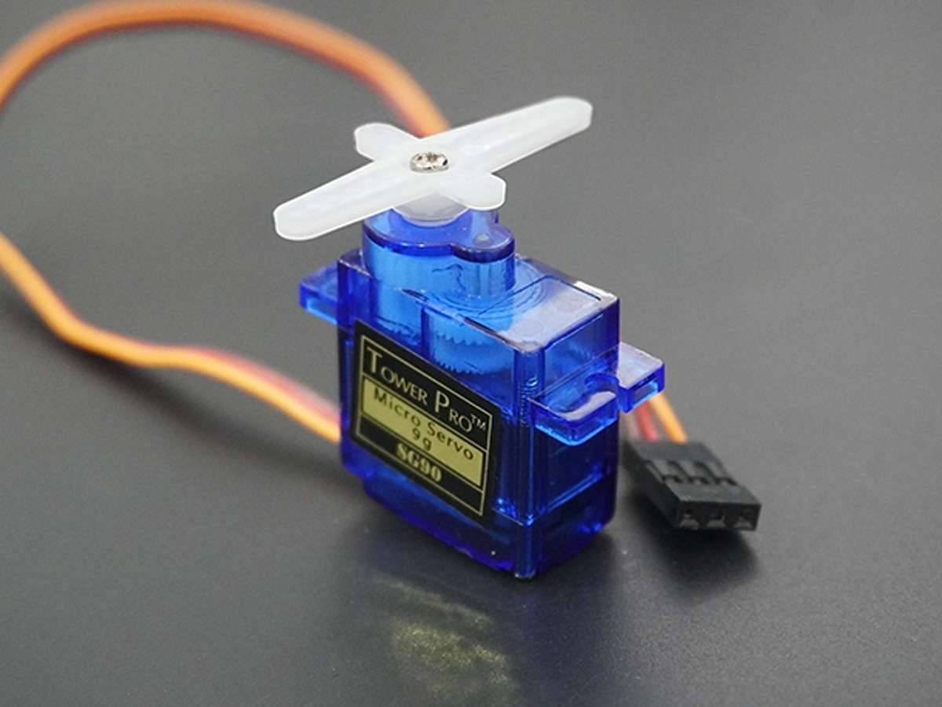
Servomotor

Slide 14
MicroPython
A dialect of Python designed for microcontrollers (μCs)

Slide 15
MicroPython
Implements a large subset of Python 3.4 (and parts of 3.5)
Runs on the metal (i.e. on systems without an operating system)
Supports a wide range of hardware/μCs(not just the Pico)
Open source and very easy to install!

Slide 16
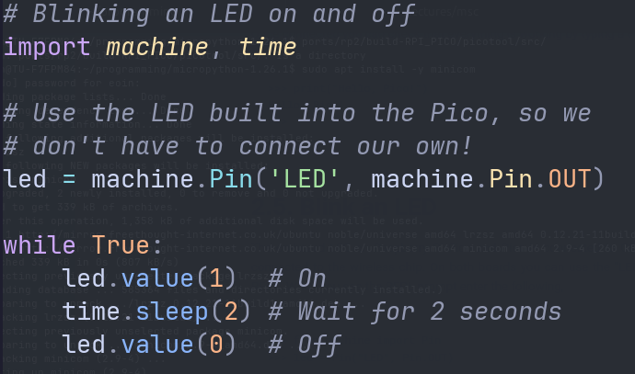
Blinking an LED on and off

Slide 17
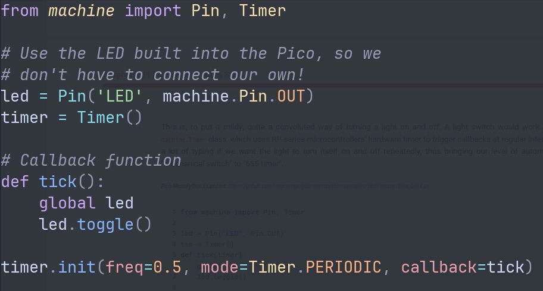
Better blinking script

Slide 18
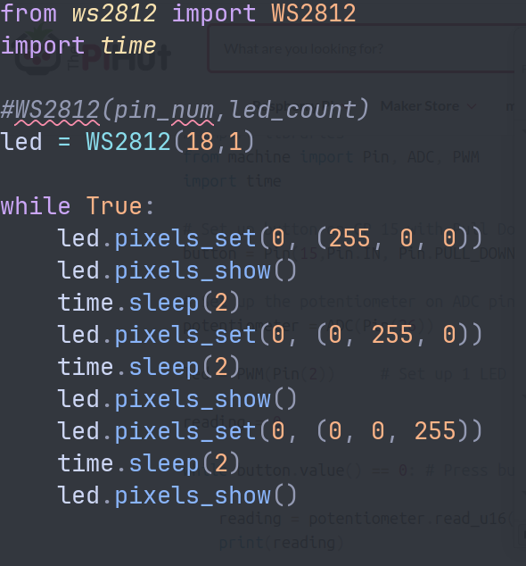
RGB LED (WS2813)

Slide 19
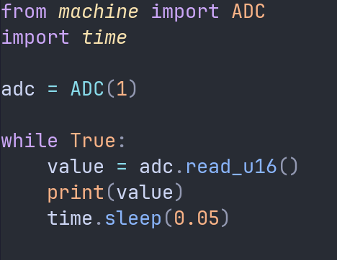
Reading from a potentiometer

Slide 20
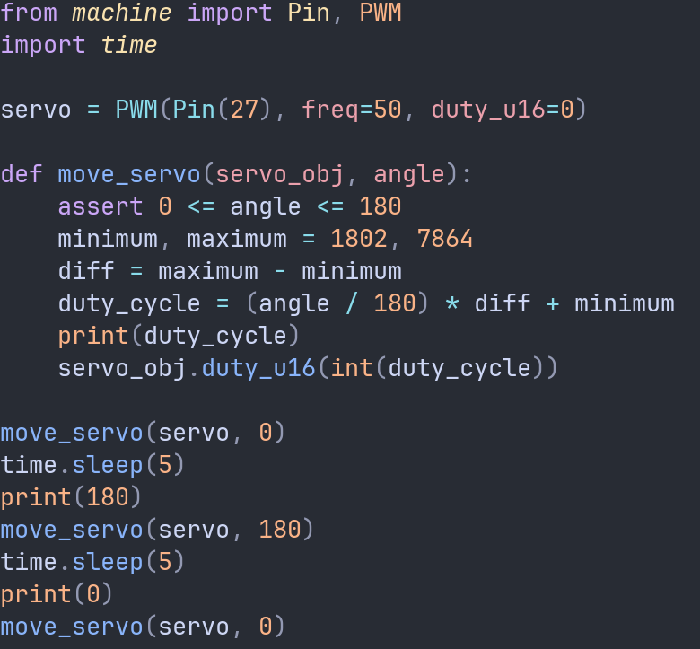
Moving a servo

Slide 21
That's all for this week
Thanks for your attention!

